Slide 1
Introduction to Python
Day 7
The Data Boot Camp |
November 20, 2018

Slide 2
Class Activity
Verify conda installation
Created? conda --version
Make it your workspace
All codes to be developed in this workspace
Activate conda environment
conda create --name <my_env>
conda info --my_env
source activate <my_env>
windows users: activate <my_env>
source deactivate <my_env>
windows users: deactivate <my_env>
conda remove --name <my_env> --all

Slide 3
Installing Conda
enter
conda create -n PythonData python=3.6 anaconda
This might take a few minutes
enter source activate PythonData
Should see (PythonData)$ at your prompt
enter source deactivate

Slide 4
Agenda
Check Python 3 installation
Navigate your desktop via the terminal
Create Python scripts and run them in the terminal
Understand basic programming concepts in Python

Slide 5
Logistic and Syntax
The Python code to be executed through either git-bash or the Mac terminal.
Windows users should always use `git-bash`
Mac users could/should use the terminal
Python:
Case-sensitive
Indentation matters
python <filename>.py
Tells the computer that this is a python file, and …
To run the code contained within
/GitLab/MINSTP201811DATA2/Instructor Notes/PYTHON-WK3.1
StudentGuide.md
Python_Reference_Guide.pdf
CommonCommand.txt
conda_pip.pdf
conda-cheatSheet.pdf

Slide 6
Let’s Start Coding

Slide 7
Instructor Demo
mkdir test_script
touch test1.py
print("Hello Python!")
touch test2.py
print("Hello again Python!")
red = terminal command
blue = folder / File
purple = python script

Slide 8
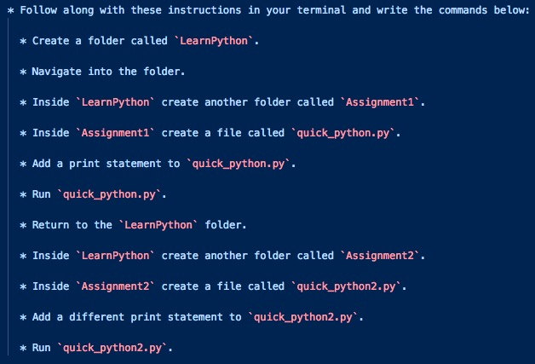
Student Activity

Slide 9
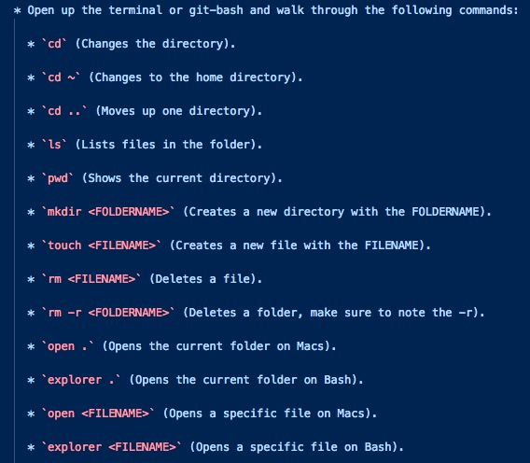
Basic Commands
All of the Python code will be executed through either git-bash or the Mac terminal.
Windows users should always use `git-bash` while Mac users should use the terminal.

Slide 10
variables

Slide 11
Introduction to Python
syntax
case-sensitive
only Classes should be capitalized
indentations matter
comments start with #
variables are dynamic:
no need to assign a data type
no need declaration key word
python figures out data type on its own
type can be changed during runtime

Slide 12
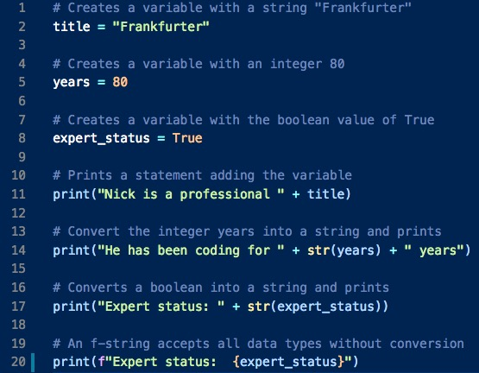
Instructor Demo - Variables

Slide 13
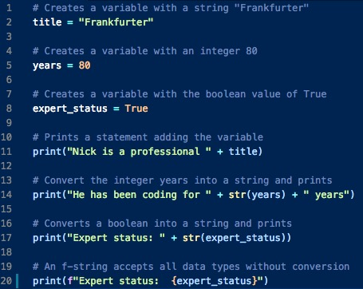
Variables

Slide 14
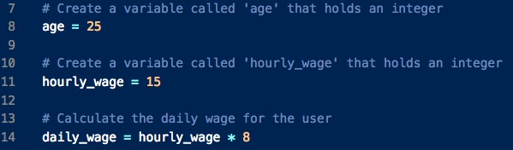
Review HelloVariableWorld
Integer variables can be used in calculation by simply referring to their names

Slide 15
Review HelloVariableWorld
Even though booleans look like strings, they do not use quotations in their declaration.
Type castings are still needed …
…unless we are using f-string
Variable need to be enclosed in { }
{daily_wage}

Slide 16
Collecting User Input

Slide 17
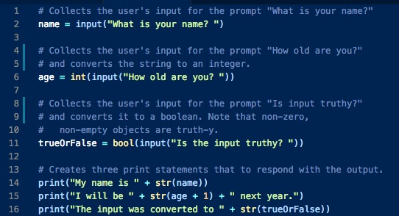

Collecting User’s Input
Line 6 can be rewritten in two parts:

Slide 18
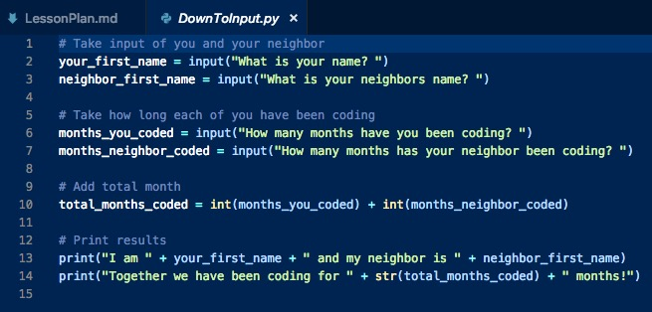
Student Activity

Slide 19
conditionals

Slide 20
Demo - Conditionals
Python uses if, elif, and else for creating conditionals.
Conditional statements are concluded with a colon but all lines after the colon **must** be indented to be considered a part of that code block. This is because Python reads blocks of code based on indentation.
The condition is equal uses == while variable assignment uses one equal sign. And != denotes not equal
Compound conditions use the words and and or

Slide 21
lists and tuples

Slide 22
Demo - Python Lists
Items (aka elements) in a list are enclosed in square brackets [ ], separated by commas.
a list can contain elements of different data types.
myList = ["Jacob", 25, "Ahmed", 80]
is base zero so index starts with zero
elements can be referenced to by enclosing the index in [ ]
print(myList[2])
output: Ahmed
specific element within a List can be changed at the given index
myList[1] = 80
print(myList)
output: ["Jacob", 80, "Ahmed", 80]

Slide 23
Demo - Python Lists cont’d 1
element can be added or removed using the append() and remove() functions respectively:
referencing the item directly
myList.append(“Matt”)
myList.remove(“Jacob”)
element can also be deleted using pop() function referencing the index
myList.pop(0)
the index function returns the index of the first object with a matching value
myList.index(80)
return 3

Slide 24
Demo - Python Lists cont’d 2
list size/length is determined using the len() function
myList = ["Jacob", 25, "Ahmed", 80]
len(myList)
return 4
as we can see, elements in lists are mutable (changeable)
tuples: lists that are immutable (unchangeable)
elements are enclosed in parenthesis
myTuple = ('Python', 100, 'VBA', False,’MongoDB’)
elements are accessed as single item or range (slicing)
Starts at index 1 then returns up to 4 elements but not 4
myTuple[1:4]
return 100, VBA, False

Slide 25
for / while loops

Slide 26
For Loop
Python
loop through a range of numbers (0-4)
loop executes 5 times
for x in range(5):
print(x)
loop through a range of numbers (2-4)
loop executes 3 times
for x in range(2, 5):
print(x)
zoo = ["cow", "dog", "bee"]
for animal in zoo:
print(animal)
VBA
loop through a range of numbers (0-5)
loop executes 6 times
for x = 0 to 5
MsgBox(x)
loop through a range of numbers (2-5)
loop executes 3 times
for x = 2 to 5
MsgBox(x)
For each worksheet in worksheets

Slide 27
While loop
while loops will run blocks of code just like a for loop does but will continue looping for as long as a condition is met.
for execute block of code for a finite number of times
while execute block of code until a condition is met
run = "y"
while run == "y":
print("Hi!")
run = input("Enter ‘y’ to continue, ‘s’ to stop: ")

Slide 28
Supplements
https://www.tutorialspoint.com/python/python_lists.htm
https://www.tutorialspoint.com/python/python_tuples.htm
https://www.pythonforbeginners.com/random/how-to-use-the-random-module-in-python

Slide 29
Questions / Discussion
Notes:
It’s important to keep in mind why you joined this class. Let’s talk about your goals.

